Slide 1
EPOCH Quick Start
Version 0.1.0
Exastro developer

Slide 2
Table of contents
Introduction
1.1 QuickStart guide
1.2 Quickstart PC Environment
2. Install
2.1 Install EPOCH
2.2 Prepare repositories
2.3 Manifest template files
3. Create Workspace
3.1 Workspace
3.2 CI/CD
3.3 CI/CD in EPOCH
3.4 Start EPOCH
3.5 Create Workspace
4. Tutorial
4.1 Tutorial overview
4.2 Sample application configuration
4.3 Tutorial (CI/CD Workflow)
4.4 Manifest template files
4.5 CI/CD Workflow No.1
4.6 CI/CD Workflow No.2
5. Appendix
5.1 Restrictions

Slide 3
1. Introduction

Slide 4

1.1 Quickstart guide
About this document
This document aims to introduce the reader to Exastro EPOCH(Hereafter written as “EPOCH”), how to install it while also guiding the reader through a simple tutorial.
QuickStart diagram
Staging environment
Production environment
EPOCH
Deploy to staging env. (Tutorial)
2
Sample application
(Pod)
Sample application
(Pod)
Sample application
(Pod)
Sample application
(Pod)
Sample application
(Pod)
1
Install EPOCH on Kubernetes environment
…
…
3
Deploy to production env (Tutorial)
（※1）
(※1)In order to keep the tutorial simple, everything will be constructed on a single Kubernetes cluster.

Slide 5




1.2 Quickstart PC environment
The following figure illustrates the PC software necessary for following this guide.
※EPOCH and/or the sample application will be built when following the QuickStart guide.
PC
Browser
(Chrome or other browsers)
EPOCH
Sample application
http
Used for operating EPOCH and checking the sample application
Terminal
(TeraTerm or other software)
ssh
> _
Environment that can run kubectl
kubectl
Used for installing EPOCH
※We will connect to the Master node in order to use kubectl.
Code editor
（Vscode or similar software）
Used for changing the sample code

Slide 6
2. Install
Install EPOCH and prepare the CI/CD environment

Slide 7



2.1 Install EPOCH (1/5)
EPOCH diagram
The following diagram illustrates EPOCH and the Workspace configuration after it has been created
EPOCH
EPOCH API group
UI
(Pod)
Resource
API
(Pod)
(Pod)
(Pod)
(Pod)
Service
API
(Pod)
CicdAPI
(Pod)
Creates Manifest file from the
Manifest templates for each environment
Deploys to K8s environment based on the Manifest files
Builds application/ Outputs image

Slide 8
2.1 Install EPOCH (2/5)
Prerequisites
Environment
A Kubernetes environment must be created
The ServiceAccount must have the cluster-admin role
The user must be able to connect to external internet from the Kubernetes environment
“Git for Windows” must be installed in the PC environment
The following port numbers must be usable(30080, 30081, 30443, 30801 , 30804, 30805, 30901～30907) (The port numbers are written in the epoch-install.yaml file. Run the installer in order to have the changes take effect)
Account
Must have a GitHub account that can register application code
Must have a GitHub account that can register Kubernetes Manifests
Must have a GitHub account that can register Container images

Slide 9
2.1 Install EPOCH (3/5)
Install EPOCH
Use a terminal to SSH login to an environment that can run kubectl. Run the following command and install EPOCH.
The following command checks the installation progress.
Check that the command result "STATUS" column displays "Running".
【Command result】
$ | kubectl apply -f https://github.com/exastro-suite/epoch/releases/download/v0.1.0/epoch-install.yaml
$ | kubectl get pod -n epoch-system
NAME READY STATUS RESTARTS AGE
epoch-cicd-api-*********-***** 1/1 Running 0 **s
epoch-rs-organization-api-*********-***** 1/1 Running 0 **s
epoch-rs-workspace-api- *********-***** 1/1 Running 0 **s
～

Slide 10
2.1 Install EPOCH (4/5)
Configure persistent volume
Configure persistent volume. This will be used for configuring the pipelines.
Run the following command and acquire the manifest from GitHub.
The following command checks the Worker nodes and host names.
【Command result】
Modify the epoch-pv.yaml file.（The last line of the epoch-pv.yaml file）
Change the “# Please specify the host name of the worker node #” text with the worker node and the host name acquired from the last command and save the file.
【Modified values】
Use the following command to reflect it to the kubernetes environment.
$ | curl -OL https://github.com/exastro-suite/epoch/releases/download/v0.1.0/epoch-pv.yaml
$ | kubectl get node
NAME STATUS ROLES AGE VERSION
epoch-kubernetes-master1 Ready control-plane,master **d v1.**.*
epoch-kubernetes-worker1 Ready worker **d v1.**.*
values:
- # Please specify the host name of the worker node #
values:
- epoch-kubernetes-worker1
$ | kubectl apply -f epoch-pv.yaml

Slide 11
2.1 Install EPOCH (5/5)
Install ArgoRollout
Run the following command to install ArgoRollout.
$ | kubectl create namespace argo-rollouts
$ | kubectl apply -n argo-rollouts -f https://github.com/argoproj/argo-rollouts/releases/latest/download/install.yaml
This concludes the steps to installing EPOCH.
Let us prepare for the tutorial!

Slide 12
2.2 Prepare repositories (1/4)
About the repositories
The repositories used in this document are as following
Repository for application codes
Repository for IaC (Staging environment)
Repository for IaC (Production environment)
Repository diagram
Sample repository
Repositories used in this scenario
Sample application
Application code repository
IaC Repository
(Staging)
IaC Repository
(Production)
Download the sample application code and commit and push it

Slide 13
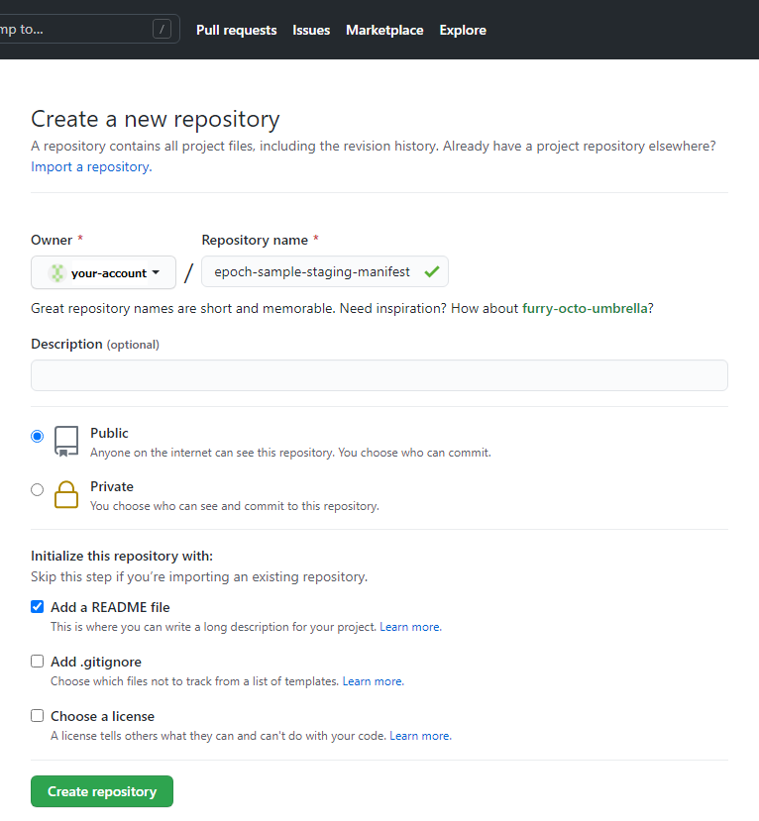
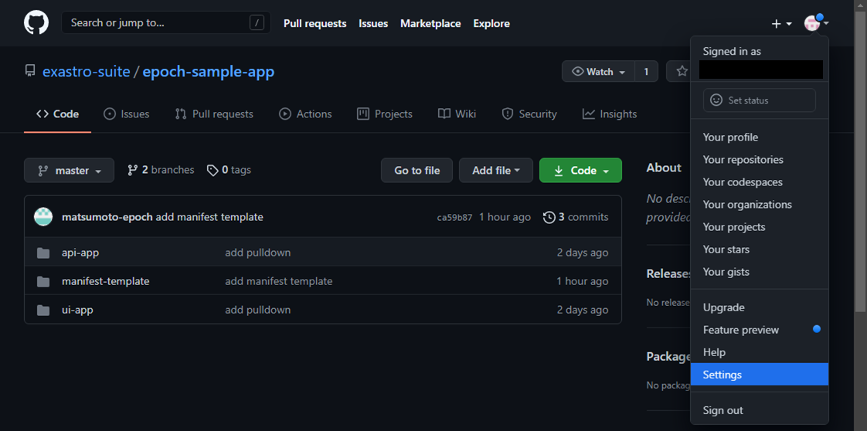
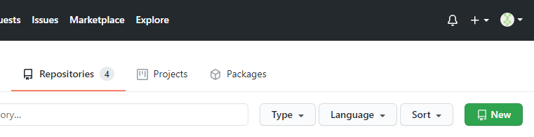
2.2 Prepare repositories (2/4)
Prepare the repositories
Prepare 3 Git repositories.
Use your browser to sign into GitHub with your own GitHub account.
Go to the account menu and press “Your repositories”.
Press the “New” button in the upper right corner and follow the diagram below to fill in the values and create the repository.
Lastly, press the “Create repository” button.
Specify the following Repository names
１：epoch-sample-app
２：epoch-sample-staging-manifest
３：epoch-sample-production-manifest
Account menu
Check the “Add a README File”

Slide 14
2.2 Prepare repositories (3/4)
Prepare repository for application code.
Clone the Application code repository
Clone the Application code repository to the PC environment.
The commando prompt should look something like this:
The next part of the tutorial will use the cloned local repository.
> > > > > | cd “[clone folder]" git clone https://github.com/[Github account name]/epoch-sample-app.git cd epoch-sample-app git config user.name “[GitHub user name]" git config user.email “[GitHub email address]"

Slide 15
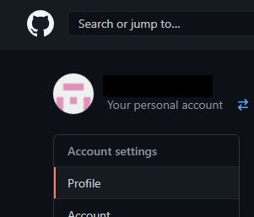
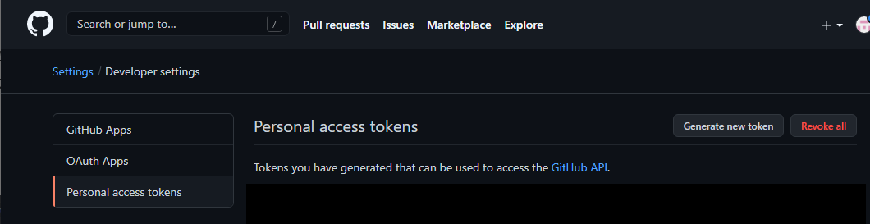
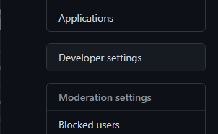
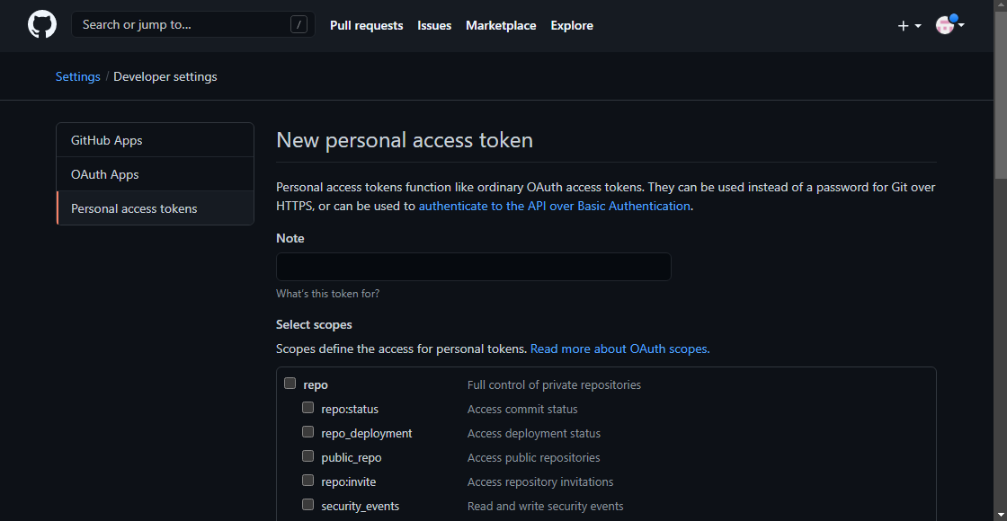
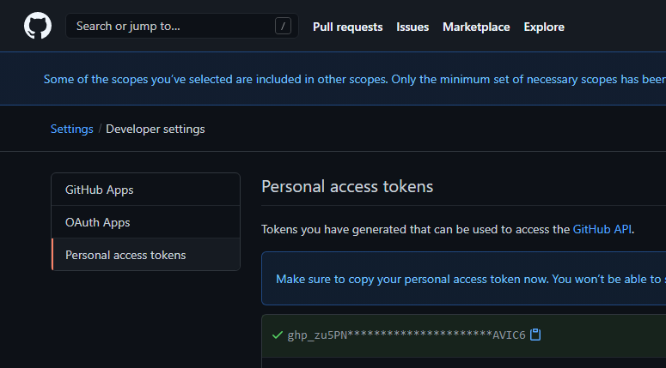
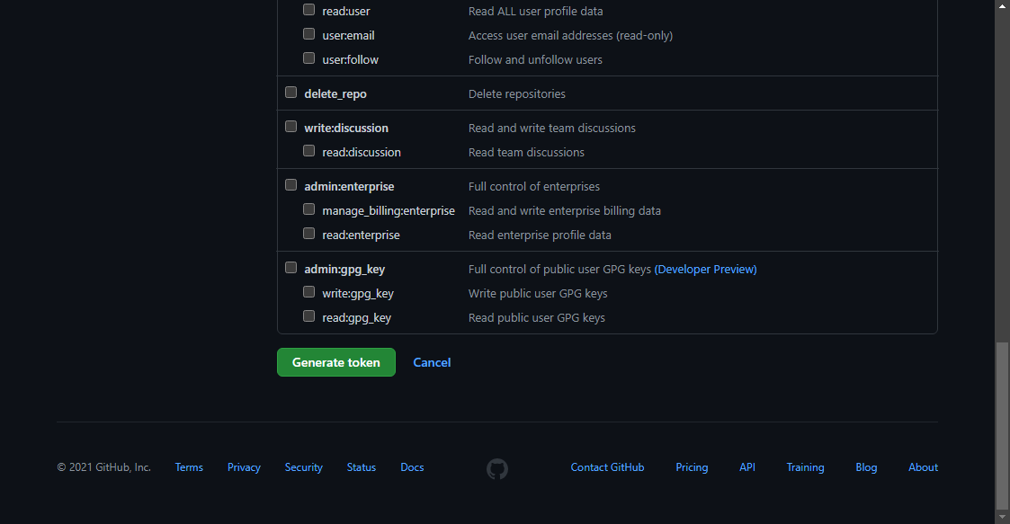
2.2 Prepare repositories (4/4)
Pay out Git token
Use your browser to sign into GitHub with your own GitHub account.
Go to the account menu and press “Settings”.
Go to the Account settings and then to the “Developer settings” menu.
Go to the “Personal access tokens” menu and press “Generate new token”.
Input a name om the “Note” field and select all the scoped before pressing the “Generate token”
The token (ghp_***) will be used later , so make sure to save it somewhere.
Account menu
Token

Slide 16
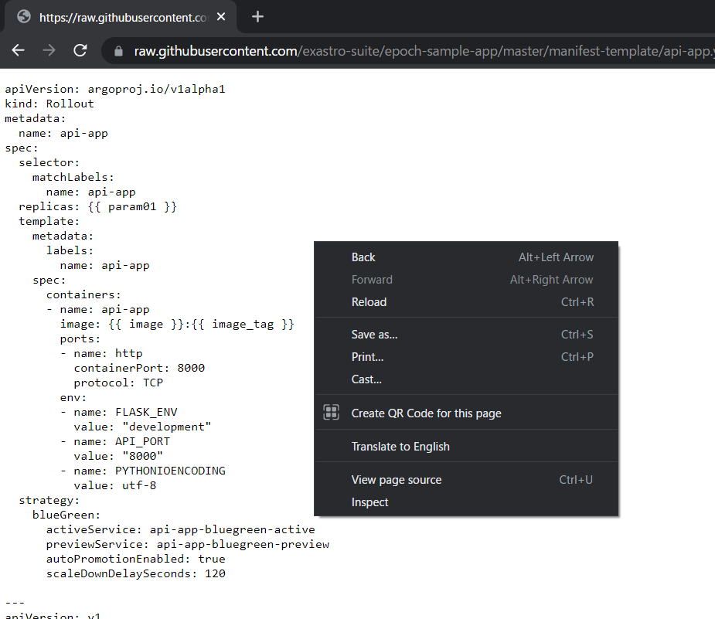
2.3 Manifest template files
Download Manifest template files
Download the 2 Manifest template files we will upload to EPOCH.
Access the files from the following URLs.
File１： https://raw.githubusercontent.com/exastro-suite/epoch-sample-app/master/manifest-template/api-app.yaml
File 2： https://raw.githubusercontent.com/exastro-suite/epoch-sample-app/master/manifest-template/ui-app.yaml
The Manifest template will be displayed in the browser window. Save the template to the PC.
Make sure to save it as an YAML file by right clicking and pressing “Save as …”.
That concludes the preparation.
In the next part, we will create our workspace.

Slide 17
3. Create Workspace
Create Workspace and prepare CI/CD.

Slide 18
3.1 Workspace
Workspace
In EPOCH, the word “Workspace” specifies a workspace for 1 development environment.
A workspace can be created by inputting the necessary information on the EPOCH screen.
EPOCH
Workspace
EPOCH API group
UI
(Pod)
Resource
API
(Pod)
Device(Browser)
Configured with the info input for each app
Information
is input from
the browser
window
Service
API
(Pod)
CI/CD API
(Pod)

Slide 19



3.2 CI/CD
What is CI/CD?
CI/CD is a method for developers to increase the frequency of app delivery by automating the tasks from app development to release.
CI（Continuous Integration）
CI is the name of the process of automated building and testing application code whenever there has been a change to it.
CD（Continuous Delivery）
CD is the name of the process of automating the tasks of releasing the code to the runtime environment.
CI/CD image
CI
CD
DevOps
Pod
Container image
Test
Application code
Pod
Pod
Release
Commit＆Push app code
Build

Slide 20
3.3 CI/CD in EPOCH
CI/CD in EPOCH
The following diagram illustrates the CI/CD used in EPOCH.
Legend
CI Pipeline
Configure per app code
CI
Continuous Integration
CD
Continuous Delivery
Clone app code
Static analysis
Build Image
Test
Push
Image
DevOps
Application code
Container image
Commit&Push
Webhook
settings
Register /Update
CD Pipeline
Configure per environment
Runtest environment
Start CD
Manifest
Template
Manifest
Parameter
Manifest
Pod
Manifest
parameter
Embedded
variables
Manifest
Push
Manifest
Update notification
Acquire Manifest
Deploy
Pod
Pod

Slide 21
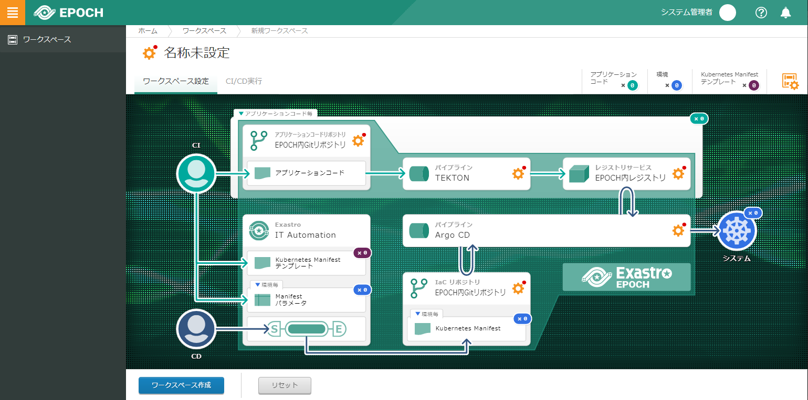
3.4 Start EPOCH
Use the following URL to access the EPOCH environment.
https://[IP Address or Host name]:30443/workspace.html
In the next step, we will input all the necessary information and create a Workspace!

Slide 22
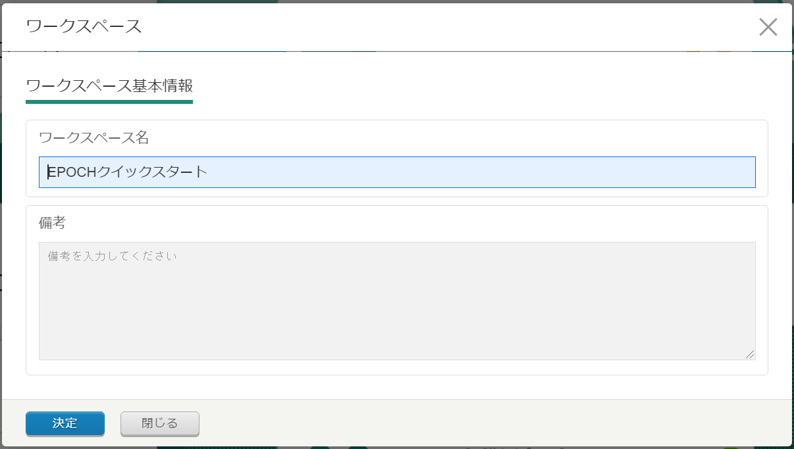
3.5 Create Workspace (1/7)
Workspace information
Input the Workspace name.
Press “Enter”
Item name | Input・Select values | Description
Workspace name | EPOCH Quickstart | Name of the workspace
Remarks | BLANK | Free space for describing the workspace

Slide 23
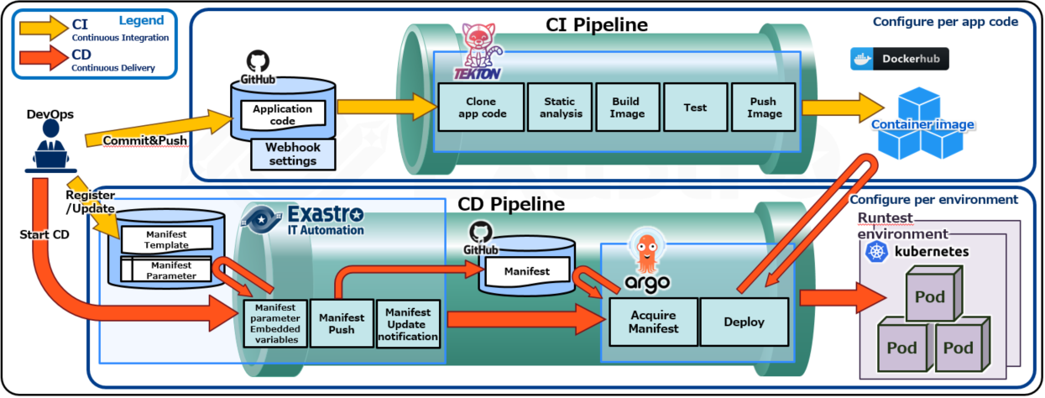
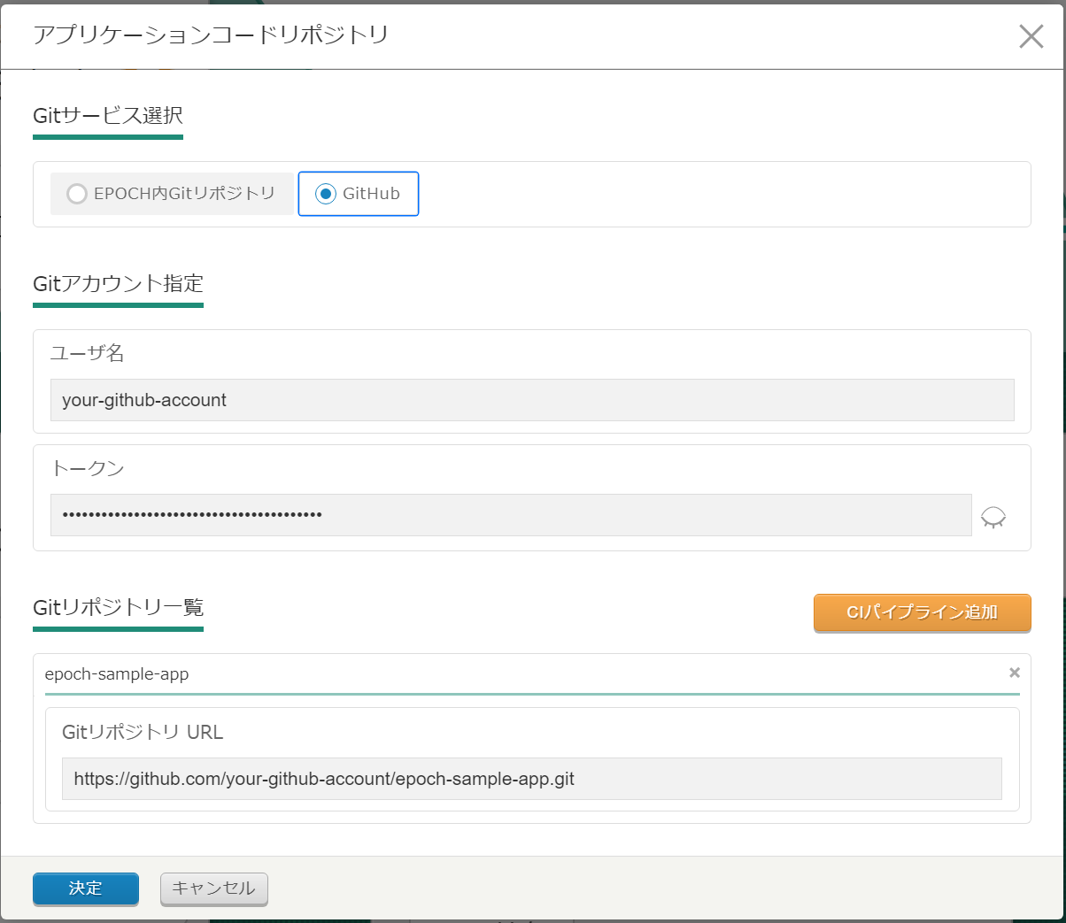
3.5 Create Workspace (2/7)
App code repository
Input information for the application code repository.
Select “GitHub”
※This section specifies the areas marked in red
Press “Enter”
Item | Input/Select | Description
User name | (GitHub account name) | Your personal GitHub account name
Token | (GitHub token) | GitHub token （See the Git token you created earlier）
Git Repository URL | https://github.com/[GitHub account name]/epoch-sample-app.git | Input the URL for the application code repository you created earlier.

Slide 24
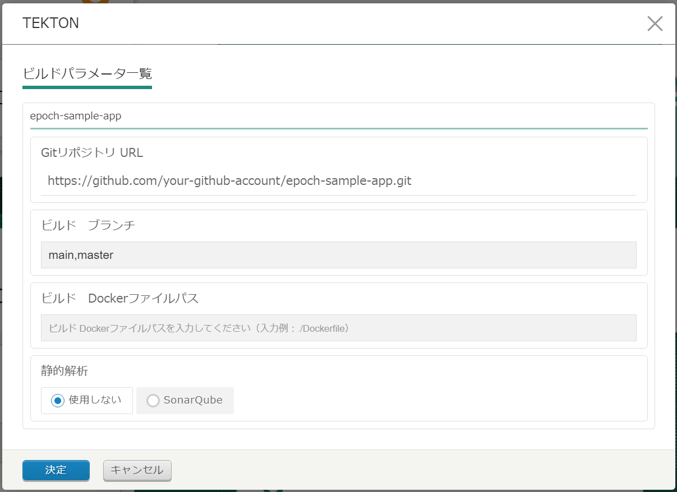
3.5 Create Workspace (3/7)
TEKTON Pipeline
Input information for the pipeline that will be set to TEKTON.
※This section specifies the areas marked in red
※Static response tests and other tests are planned to be added in the future.
Select “None”
Press “ENTER”
Item | Input/Select | 説明
Build branch | main,master | The build's target GitHub application branch
Docker build file path | ./api-app/Dockerfile | Application docker file path

Slide 25
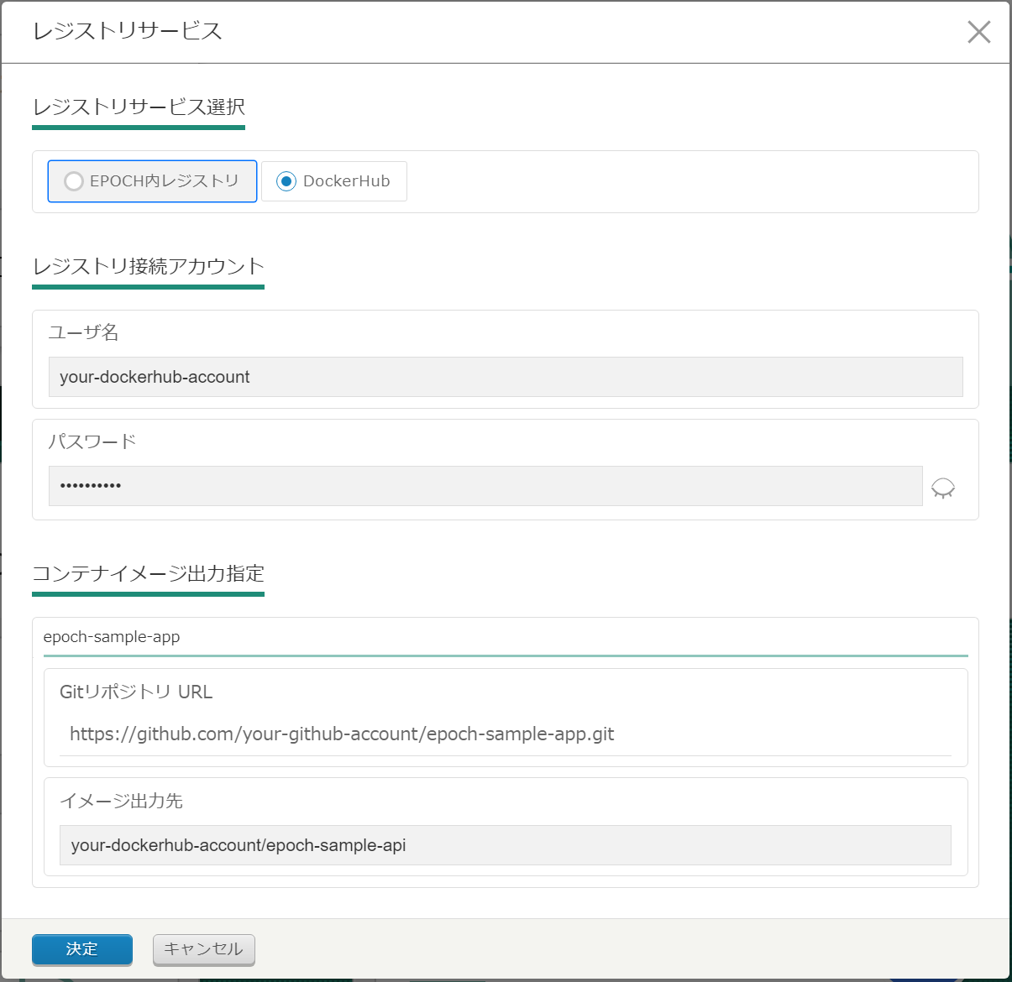
3.5 Create Workspace (4/7)
Registry service
Input the image registration destination (Registry).
※This section specifies the areas marked in red
Select DockerHub
Press “Enter”
Item | Input/Select | Desciption
User name | （Your personal DockerHub account name） | DockerHub account name
Password | （Your personal DockerHub password） | DockerHub password
Image output destination | [DockerHub account name]/epoch-sample-api ※Modify the text that displays after inputing the user name. | DockerHub image output destination

Slide 26
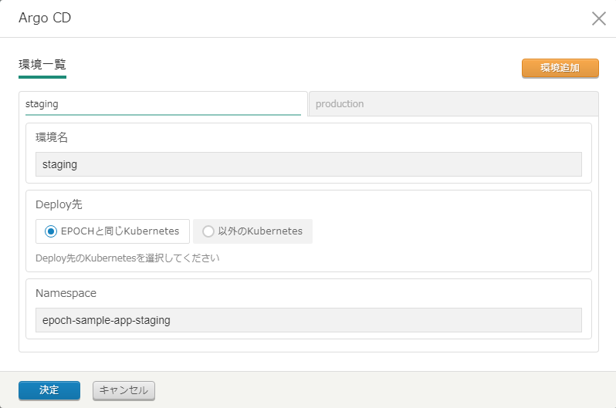
3.5 Create Workspace (5/7)
Argo CD Pipeline
Input the Deploy information that will be set to ArgoCD.
Use the tabs on the top to change between environment 1 and 2
※This section specifies the areas marked in red
The tutorial in this guide will deploy to 2 environments. Press the "Add environment" button to add a new environment.
Select “EPOCH and Kubernetes”
Press “Enter”
Environment 1：Staging environment
Item | Input/Select | Description
Environment name | staging | Name of the environment
Namespace | epoch-sample-app-staging | Deploy destination Namespace
Evnrionment2：Production environment
Item | Input/Select | Description
Environment name | production | Name of the environment
Namespace | epoch-sample-app-production | Deploy destination Namespace

Slide 27
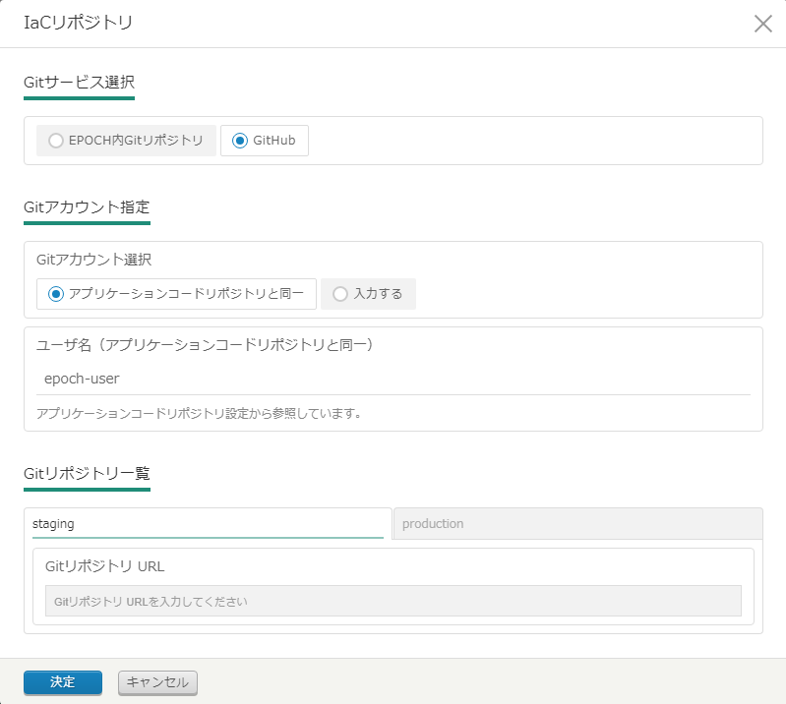
3.5 Create Workspace (6/7)
IaC repository
Input the repository information. This will determine where the manifest will be registered to.
※This section specifies the areas marked in red
Select “GitHub”
Select “XXX”
Input for each environment
Press “Enter”
Item | Input/Select | Description
Git repository URL | https://github.com/[GitHub account name]/[Environment repository].git | The Environment’s Manifest repository. （See the IaC repository we prepared earlier）

Slide 28
3.5 Create Workspace (7/7)
Create workspace
After you have input all the necessary information, press “Create Workspace”.
Press “Create Workspace”
You have now created the CI/CD pipeline!
The next tutorial will guide you through a scenario of using the CI/CD pipeline.!

Slide 29
4. Tutorial
Let’s use the CD/CD workflow

Slide 30

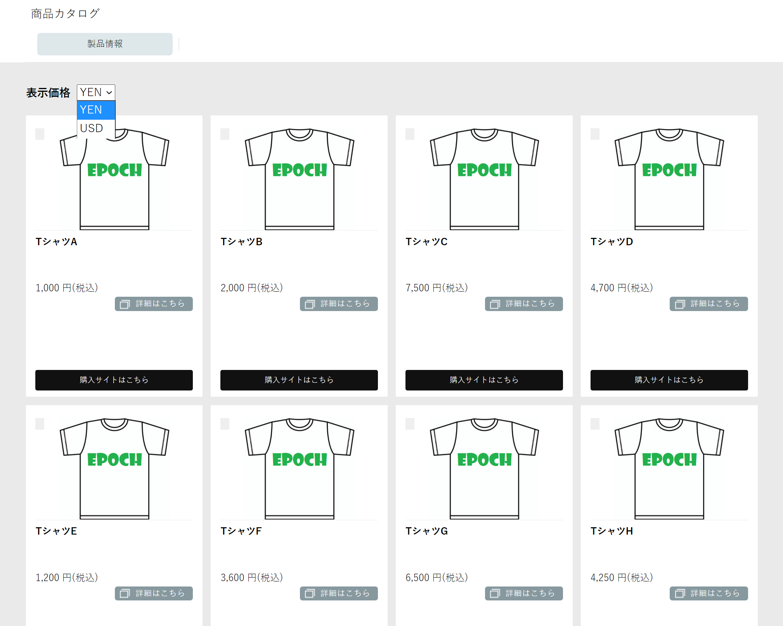
4.1 Tutorial overview (1/2)
CI/CD development scenario
This tutorial uses the following scenario as a base to guide the reader through a CI/CD workflow.
In this tutorial, the reader will create an EC site by using a prepared sample application.
The client wants you to develop an EC site app
Can you make us an EC site for selling T-shirts?
Client
Of course!
We also want it to be cloudnative and use CI/CD.
I need to configure a container orchestration in Kubernetes and prepare a pipeline for both CI/CD.
I also need to configure a trigger, where I will need to do this and this...
I want the CD to be a fault-tolerant system, so I will need to think about the different patterns...
DevOps
Client
I will try…
DevOps
Covered in
page 34 - 58
I will need a pod for the UI and the BackEnd (API), as well as two different environments for staging and production
CI/CD Workflow No.1
DevOps
There sure is a lot to do.
There must be an easier way to do this…
Wait, didn't EPOCH support CI/CD?
Create an EC site that supports
both Japanese Yen (YEN) and American dollar (USD)
Let’s try and use EPOCH!
Done！
DevOps

Slide 31
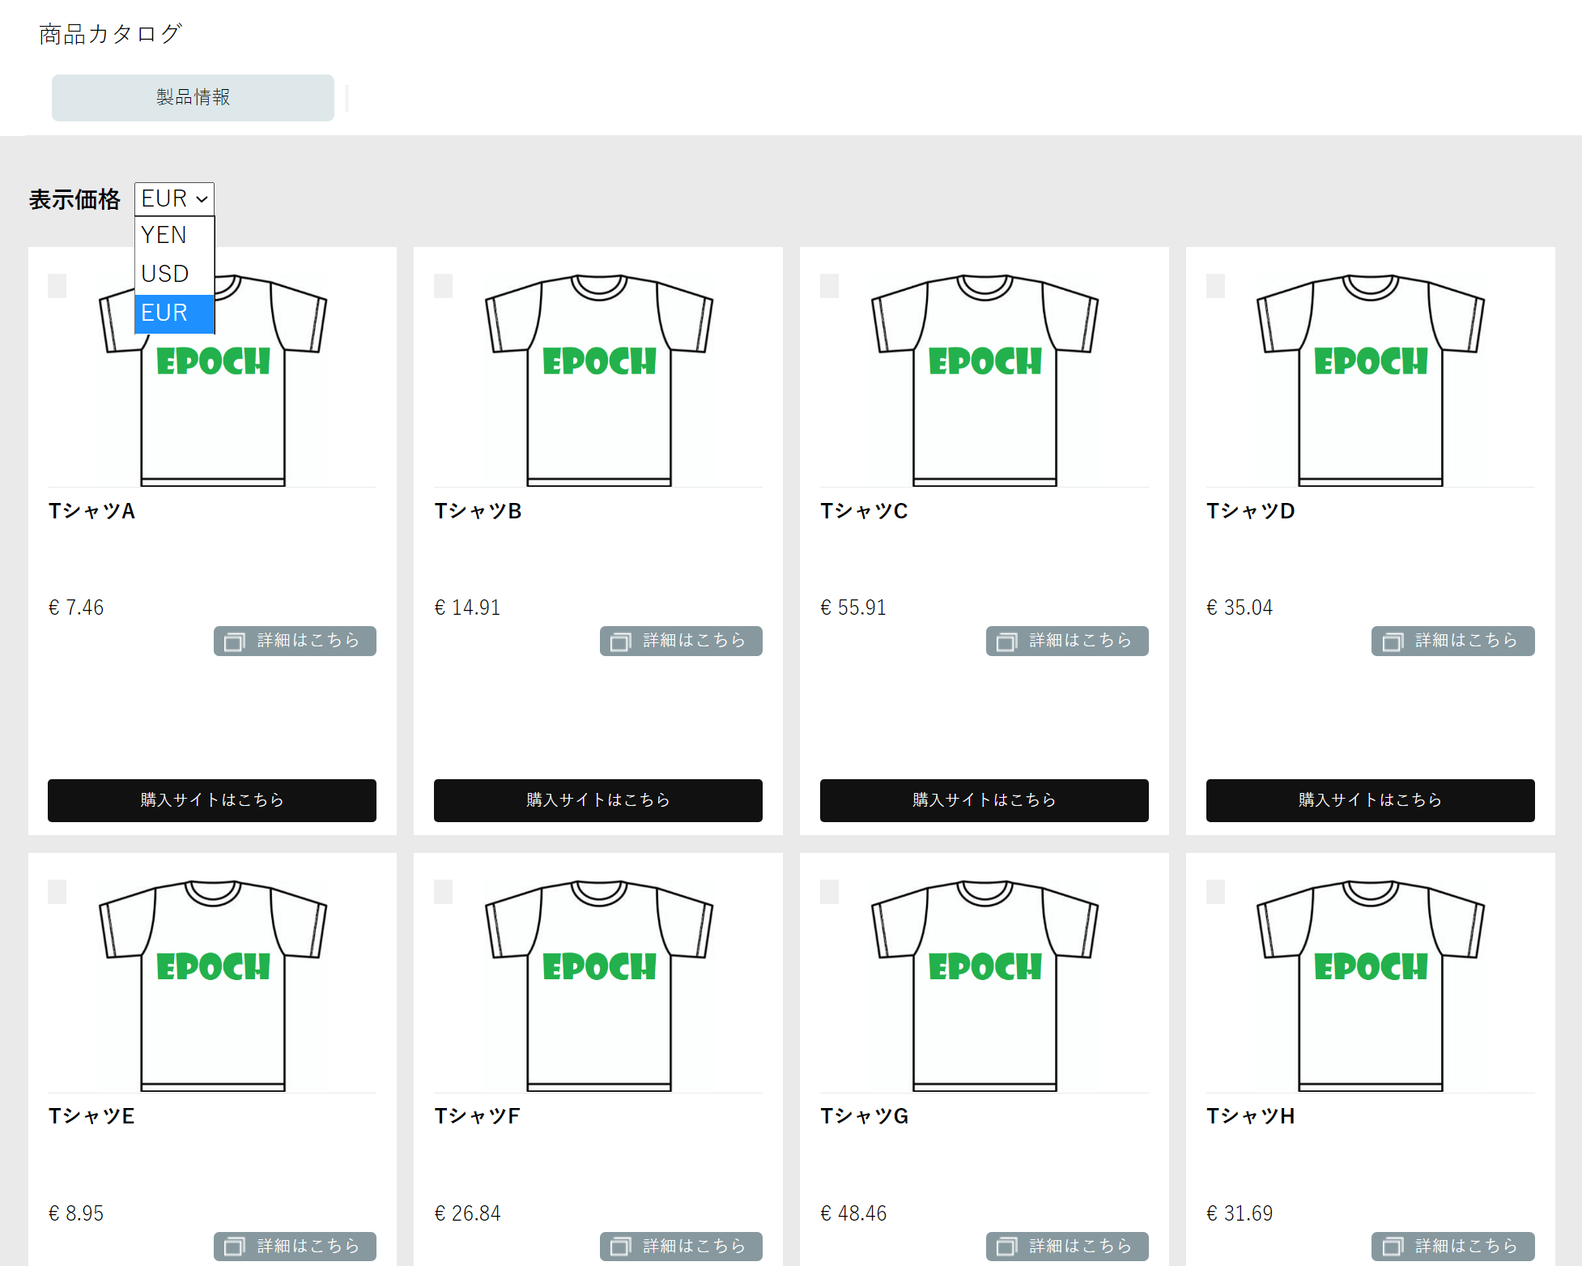
4.1 Tutorial overview (2/2)
The client asks for a new
The EC site is doing great!
Client
That is good to hear
We want to appeal to the European market as well. Can we add Euro as well?
DevOps
Client
Of course!
DevOps
The CI/CD is already completed, so it's easy to deploy once I've fixed the code!
Covered in page 59 - 80.
CI/CD Workflow No.1
DevOps
Update the EC site so that it supports Euro(EUR) in addition to JPY and USD
Done！
DevOps

Slide 32




4.2 Sample application configuration
Sample application configuration
The sample application is created by an UI and an API.
namespace
In this guide, we will add currency information to the API.
Sample application
UI
(Pod)
API
(Pod)
nodePort
Internal Port
Maintains the App UI.
Calls the API and acquires/displays the contents (products/currency)
Returns product list for when called
Returns currency list when called

Slide 33
4.3 Tutorial (CI/CD workflow)
CI/CD workflow
In this scenario, the user will deploy the sample code to both the Staging and the Production environment. After that, they will modify the sample code and proceed to deploy it to both the Staging and the Production environment.
The first workflow will have the user download the sample application code and commit and push it.
The second workflow will have the user modify the code and commit and push it.
EPOCH
Production env
Commit & Push Application code
Check CI results
※3 UI Pods will be created in the Production environment
UI
(Pod)
Upload
Manifest template
CI
UI
(Pod)
CD
Configure Manifest parameters
Staging env
Start CD to Staging environment
Start CD to Production environment
UI
(Pod)
API
(Pod)
UI
(Pod)
API
(Pod)
Check CD results
Check CD results

Slide 34
4.4 Manifest template file
Manifest template file
There are two Manifest template files for the sample application. One for UI and one for API.
They are template files that have modifiable variables for matching environments.
Manifest template file
The Manifest parameters that we will edit are the following 5
１． param01 … Replica number
２． image … Image URL
３． image_tag … Image tag
４． param02 … Port number for the active side
５． param03 … Port number for the preview side
ui-app.yaml
api-app.yaml
※The variable names supports the following names image, image tag, param01~param20
In the next section, we will start the first CI/CD workflow!

Slide 35
CI/CD Workflow No.1

Slide 36
4.5 CI/CD Workflow No.1 (1/25)
Deploy to Staging environment
The first CI/CD workflow will have the user commit and push the application code, deploy it to the Staging environment, as well as checking the results of the CD.
EPOCH
Production env
Commit & Push Application code
Check CI results
※3 UI Pods will be created in the Production environment
UI
(Pod)
Upload
Manifest template
CI
UI
(Pod)
CD
Configure Manifest parameters
Staging env
Start CD to Staging environment
Start CD to Production environment
UI
(Pod)
API
(Pod)
UI
(Pod)
API
(Pod)
Check CD results
Check CD results

Slide 37
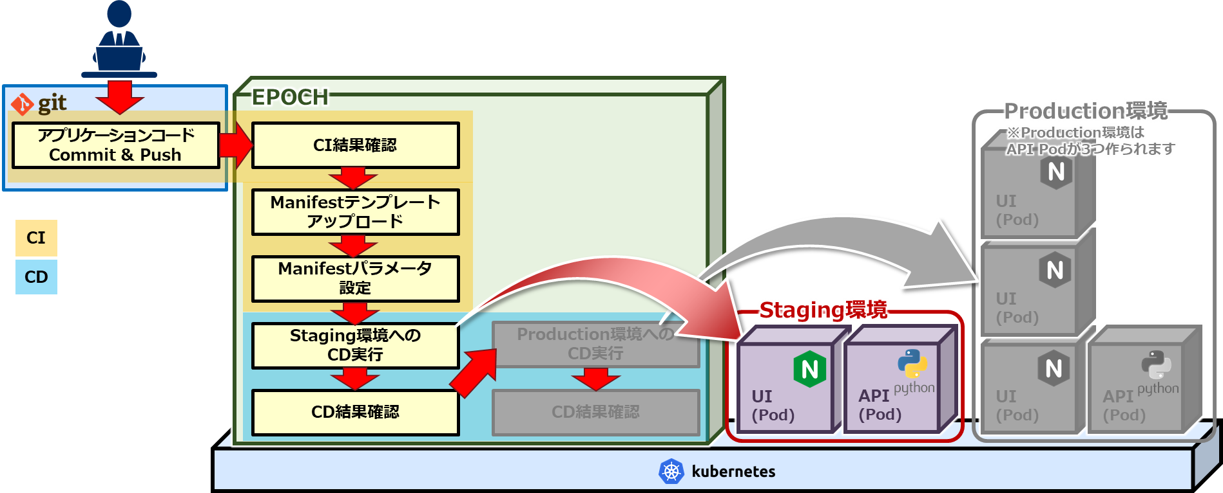
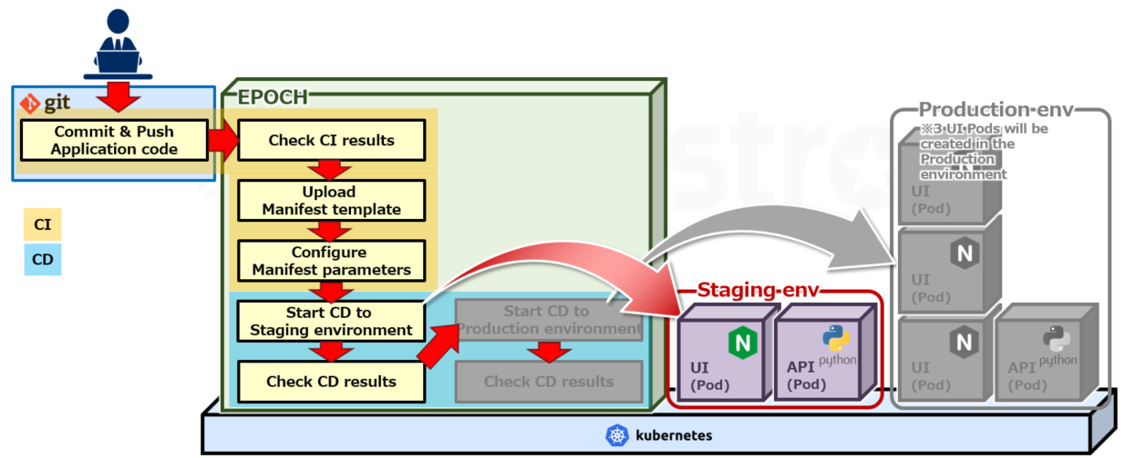
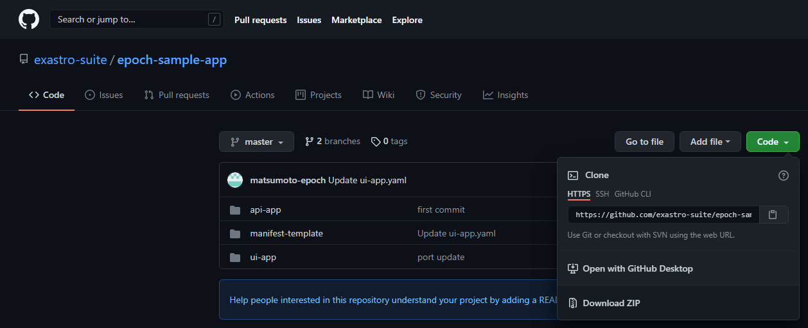
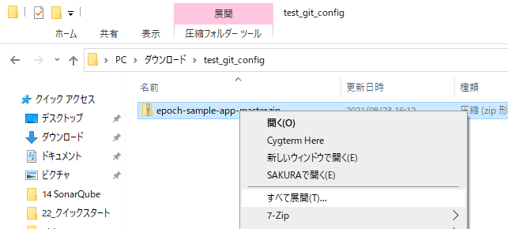
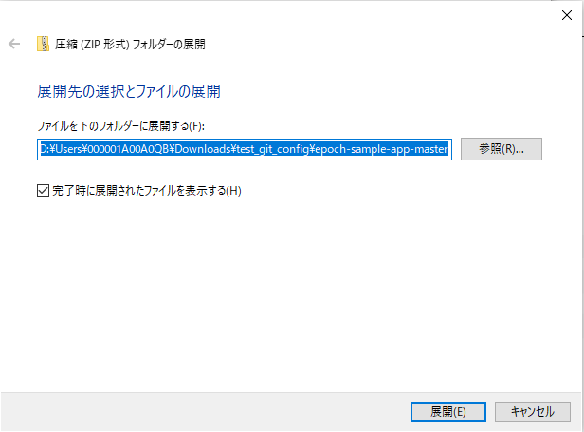
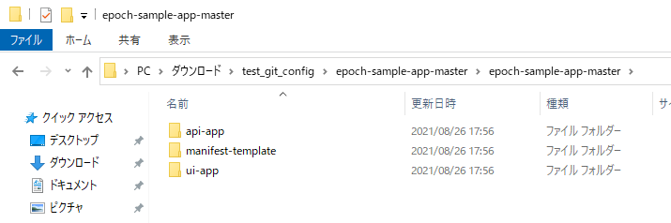
4.5 CI/CD Workflow No.1 (2/25)
Commit & Push Application code
Run the CI Pipeline in order to create the container image we will deploy.
Access the following URL to download the sample app. https://github.com/exastro-suite/epoch-sample-app
From the GitHub page, press the "Code" button and "Download ZIP" in order to download the code.
Extract the zip file and copy it to the cloned application code repositories.
Copy to these 3 repositories

Slide 38
4.5 CI/CD Workflow No.1 (3/25)
Commit and Push to the Cloned application code repository.
The commando prompt should look something like this:
※ If you are asked to authenticate yourself when you are running the git push command, input the necessary GitHub account information.
When you have successfully run the Push command, The CI Pipeline set by the TEKTON Pipeline should automatically start.
Now we need to check the CI Pipeline results.
> > > | git add . git commit -m "first build" git push origin main

Slide 39
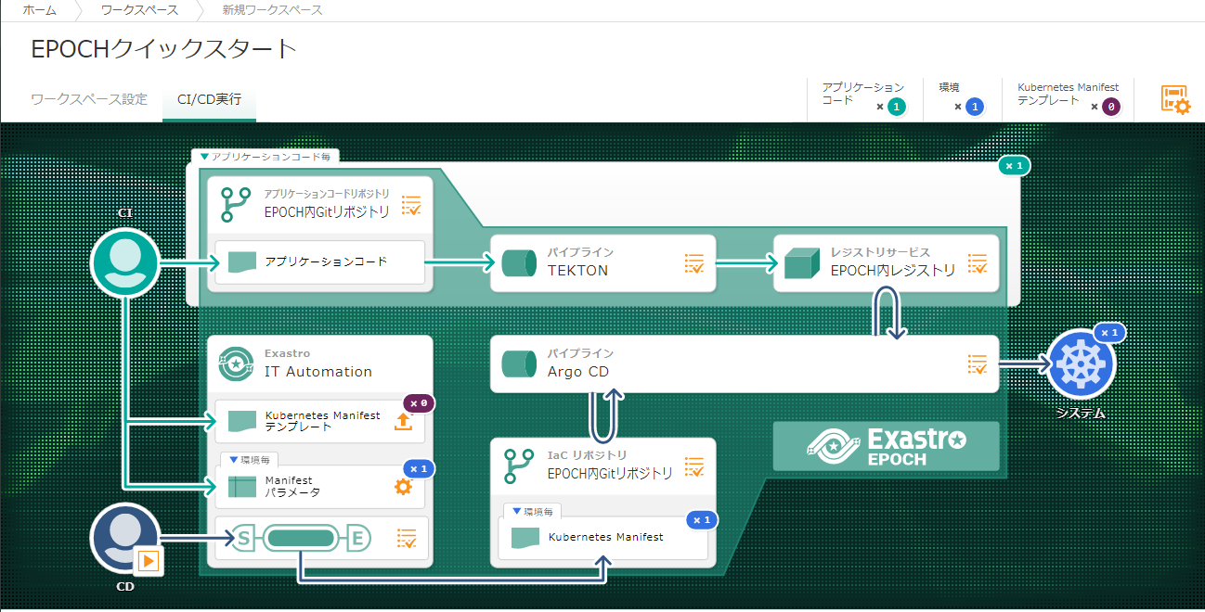
4.5 CI/CD Workflow No.1 (4/25)
CI/CD Execution screen
Press the CI/CD Tab in the Workspace screen to go to the CI/CD Execution screen.
Click the CI/CD Tab

Slide 40
4.5 CI/CD Workflow No.1 (5/25)
Check CI results
Check the build results of the Application code.
Running the Git push command will start the CI Pipeline.
Users can press this icon in order to see the results.
Let us check out the CI results!

Slide 41
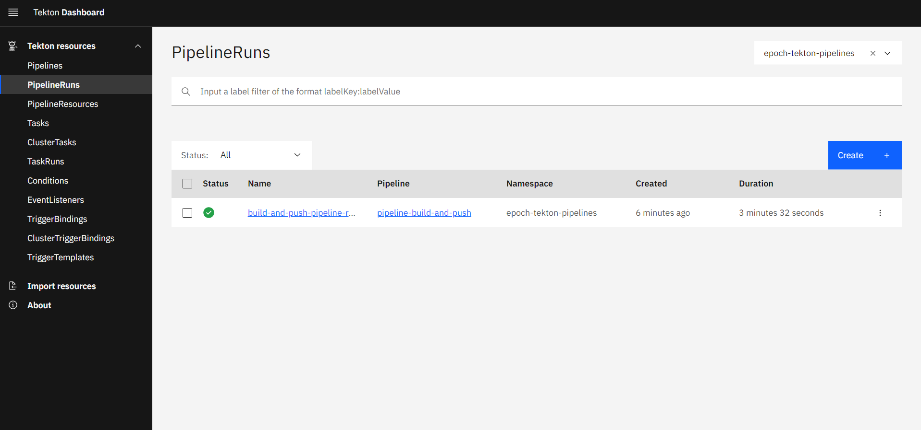
4.5 CI/CD Workflow No.1 (6/25)
Check the TEKTON Pipeline
Check the TEKTON pipeline that the build has ended successfully.
Users can check the CI Pipeline operations from the TEKTON dashboard.
By pressing the name of the operation, users can see more information regarding the CI Pipeline contents.
If the “Status” displays a green checkmark, the operation has ended successfully.

Slide 42
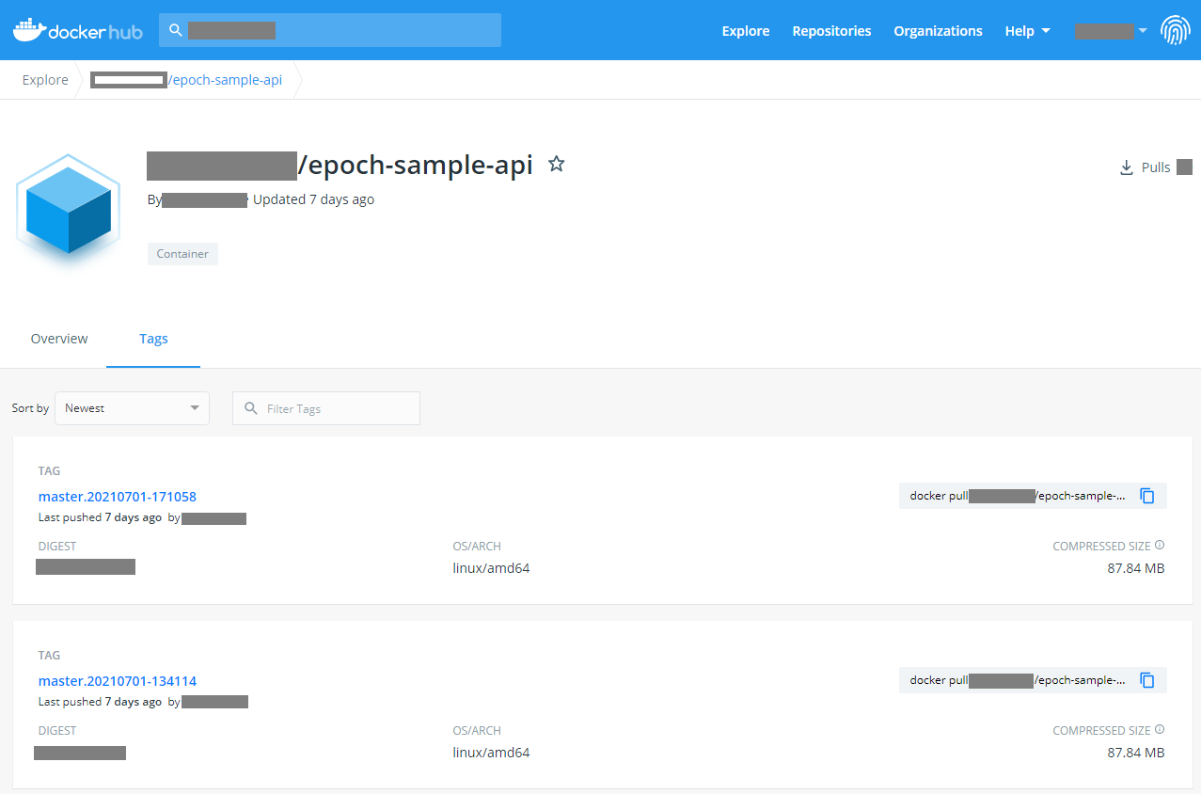
4.5 CI/CD Workflow No.1 (7/25)
Check the Container image tag name
Open the registry service screen and check the tag of the built container image.
Open the Dockerhub screen and check the epoch-sample-api tag.
※If the image isn't registered, check the results from the TEKTON pipeline
The Image tag will be used in the next step where we input it into the Manifest parameter (image_tag), so make sure to save it.
※We plan to make it possible for users to select the image_tag created in the Pipeline.

Slide 43
4.5 CI/CD Workflow No.1 (8/25)
Upload Manifest template
Upload the Manifest template we downloaded earlier
In order to start the CD pipeline, we need to upload the Manifest template.

Slide 44
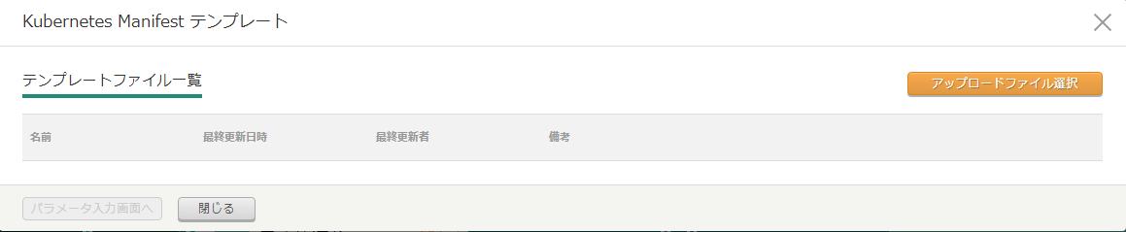
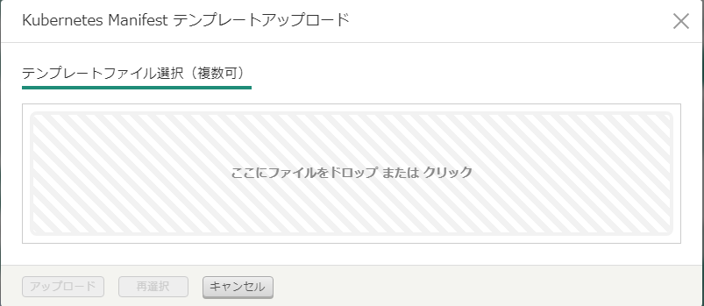
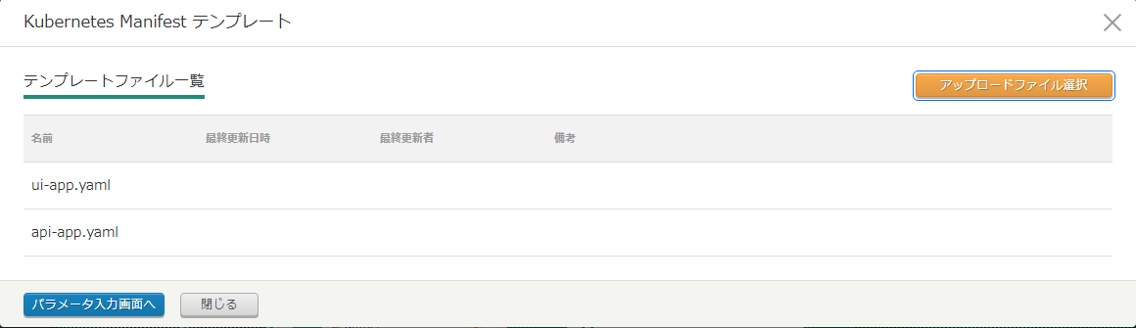
4.5 CI/CD Workflow No.1 (9/25)
Upload Manifest template
Upload the Manifest template file we prepared earlier.
Drop the api-app.yaml and ui-app.yaml files to the area on the right
Press the “Parameter” button after you uploaded the files.

Slide 45
4.5 CI/CD Workflow No.1 (10/25)
Manifest parameters
Input the Manifest parameters needed for deploying.
Input the Manifest parameters for the Manifest templates we uploaded.

Slide 46
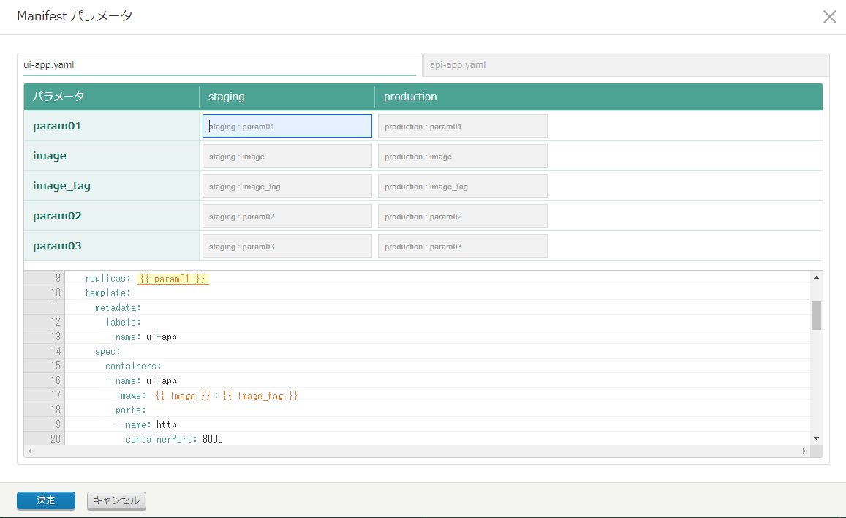
4.5 CI/CD Workflow No.1 (11/25)
Select ui-app.yaml and input the Input contents from the table below.
※The ui-app.yaml might be on the right tab, depending on the order you uploaded the files
Input Manifest parameters
Follow the table below and input the Manifest parameters
Follow the Input contents from the table below.
※Note that the values differ depending on the environment.
ui-app.yaml
Item | Input contents(staging) | Input contents(production) | Description
{{ param01 }} | 1 | 3 | Replica numbers
{{ image }} | exastro/epochsampleappui | exastro/epochsampleappui | Container image
{{ image_tag }} | master.20210708183910 | master.20210708183910 | Container image tag
{{ param02 }} | 31001 | 31003 | Port number for the blue side (Blue-Green deployment)
{{ param03 }} | 32001 | 32003 | Port number for the green side (Blue-Green deployment)
※The image_tag for ui-app.yaml is the same one from the container image we built earlier.
※We plan to make "image" and "image_tag" selection items in the future.

Slide 47
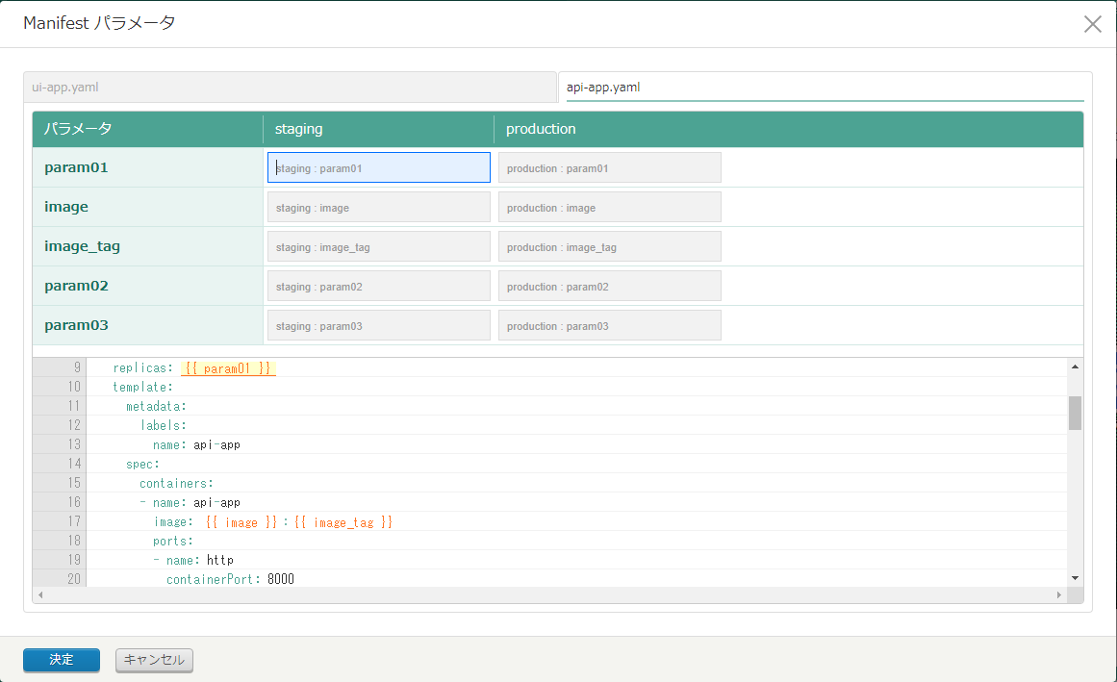
4.5 CI/CD Workflow No.1 (12/25)
Select “api-app.yaml” and input the necessary information
Change to the api-app.yaml tab and repeat.
api-app.yaml
Press “Enter”
Item | Input contents(staging) | Input contents(production) | Description
{{ param01 }} | 1 | 1 | Replica number
{{ image }} | [Dockerhub account name]/epoch-sample-api | [Dockerhub account name]/epoch-sample-api | Container image
{{ image_tag }} | [Image tag name] | [Image tag name] | Container image tag acquired from the Registry service.
{{ param02 }} | 31002 | 31004 | Port number for the blue side (Blue-Green deployment)
{{ param03 }} | 32002 | 32004 | Port number for the green side (Blue-Green deployment)

Slide 48
4.5 CI/CD Workflow No.1 (13/25)
Deploy to Staging environment
Start CD and deploy to the Staging environment.
Start CD

Slide 49
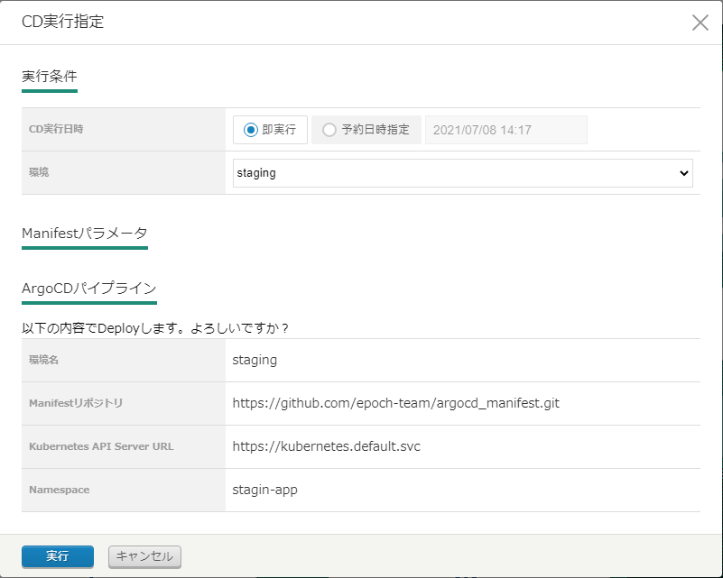
4.5 CI/CD Workflow No.1 (14/25)
Start CD for the Staging environment
Select the environment you want to deploy to.
Select “staging”
Press “Enter”
The CD process for the Staging environment has started.
Let us check that it is working as it should.

Slide 50
4.5 CI/CD Workflow No.1 (15/25)
Check the CD results
We can check the CD execution results from Exastro IT-Automation and ArgoCD.
Click the different results icons to check the CD execution results.

Slide 51
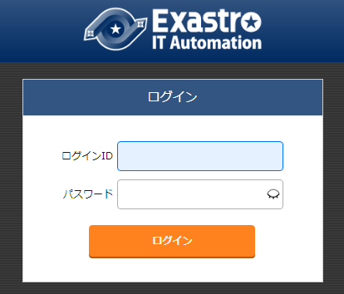
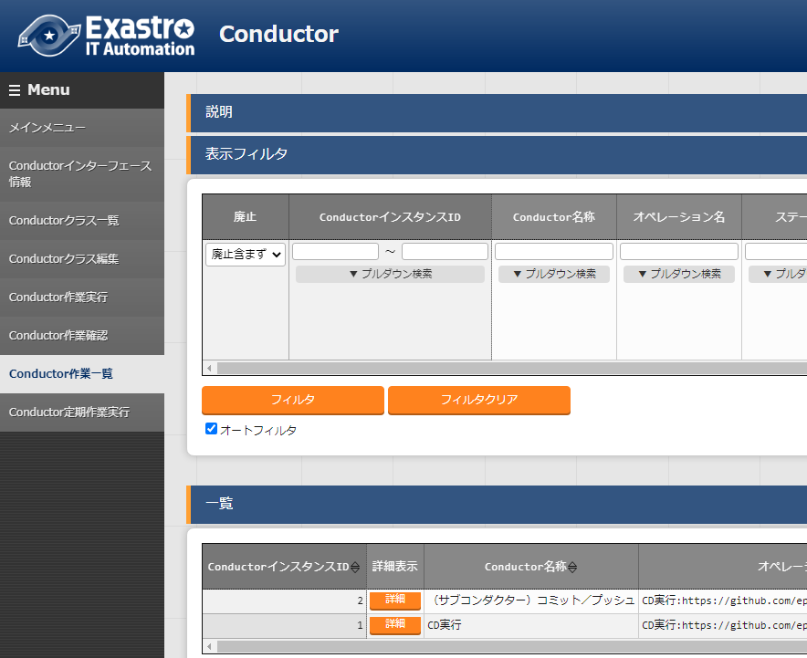
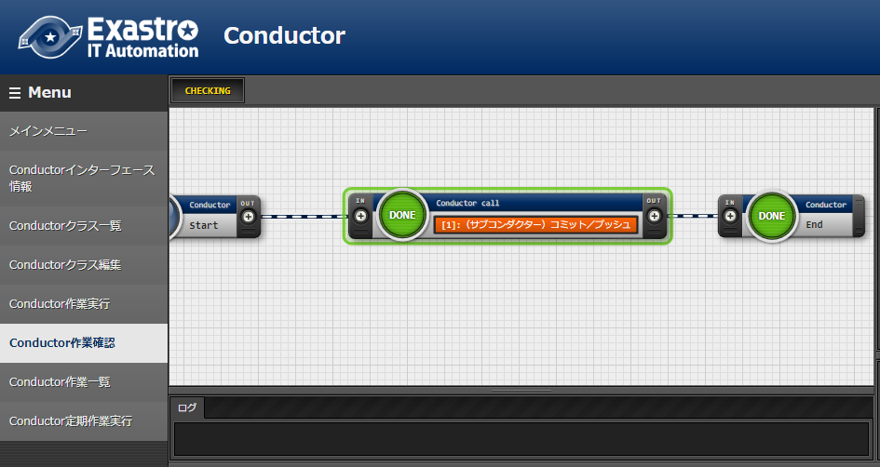
4.5 CI/CD Workflow No.1 (16/25)
Check that the Manifest file has been created (Staging environment)
Open Exastro IT-Automation and check that the Manifest file has been registered to the IaC repository.
LoginID: epoch-user Password: c2jthascR93ijdcyzwJY
[1] Go to Conductor -> Conductor list
[2]Click “Filter”
[3]Press "Details" on the "CD" record.
If all the nodes says “DONE”, then the operation has ended successfully.

Slide 52
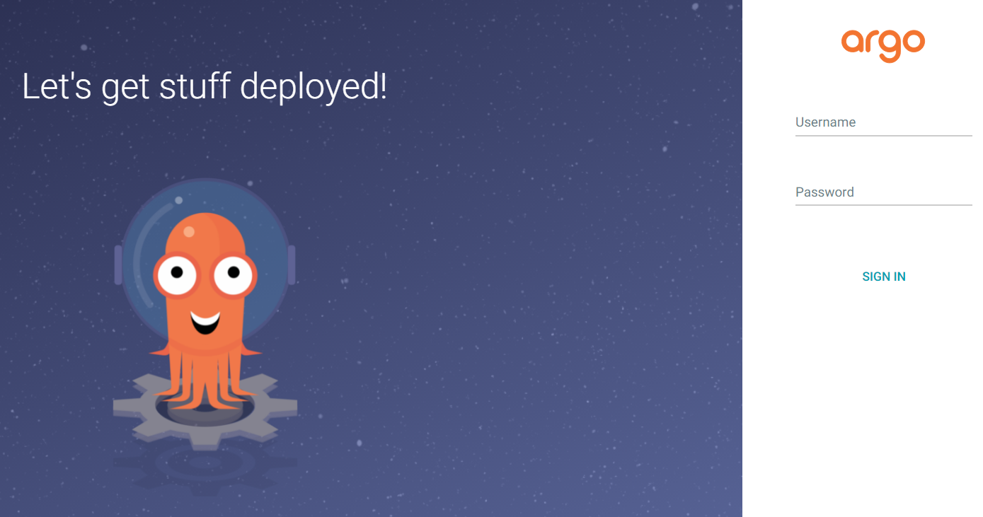
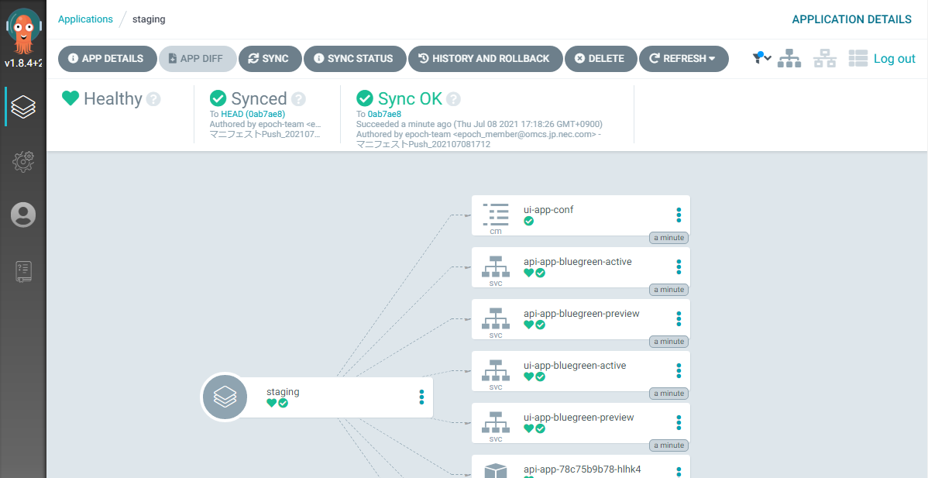
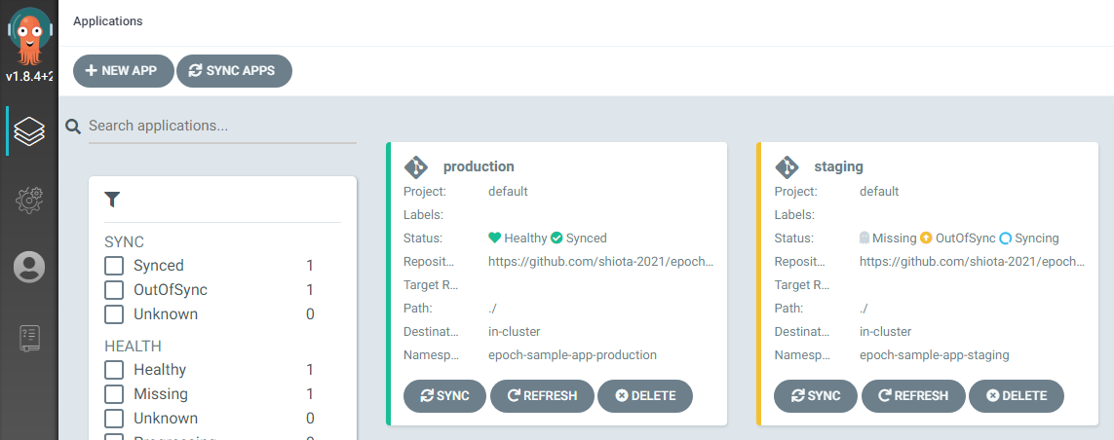
4.5 CI/CD Workflow No.1 (17/25)
Check the results of the ArgoCD Pipeline (Staging environment)
Check that the Manifest shows up on Kubernetes
Username: admin Password: iYSCKzx2wvxJnn4dCNwN Your browser might say that the connection is not secure. If that is the case, open up the “more information” tab and press “Access”.
ArgoCD synchronizes every 3 minutes.
Select staging
If the Sync status says "Sync OK", the operation is complete.
※Make sure that the displayed date/time is after the CD was run.
Let us check the deployed sample application

Slide 53
4.5 CI/CD Workflow No.1 (18/25)
Check the Staging environment sample code.
Access the sample application from the URL below http://[Kubernetes master node IP address/Host name]:31001/front-end.html
Check that both "YEN" and "USD" is displayed and selectable from the Currency pulldown selection.
Now let's deploy to the Production environment

Slide 54
4.5 CI/CD Workflow No.1 (19/25)
Deploy to Production environment
Now that we have deployed to the Staging environment and checked that everything functions as it should, we can now deploy to the Production environment.
EPOCH
Production env
Commit & Push Application code
Check CI results
※3 UI Pods will be created in the Production environment
UI
(Pod)
Upload
Manifest template
CI
UI
(Pod)
CD
Configure Manifest parameters
Staging env
Start CD to Staging environment
Start CD to Production environment
UI
(Pod)
API
(Pod)
UI
(Pod)
API
(Pod)
Check CD results
Check CD results

Slide 55
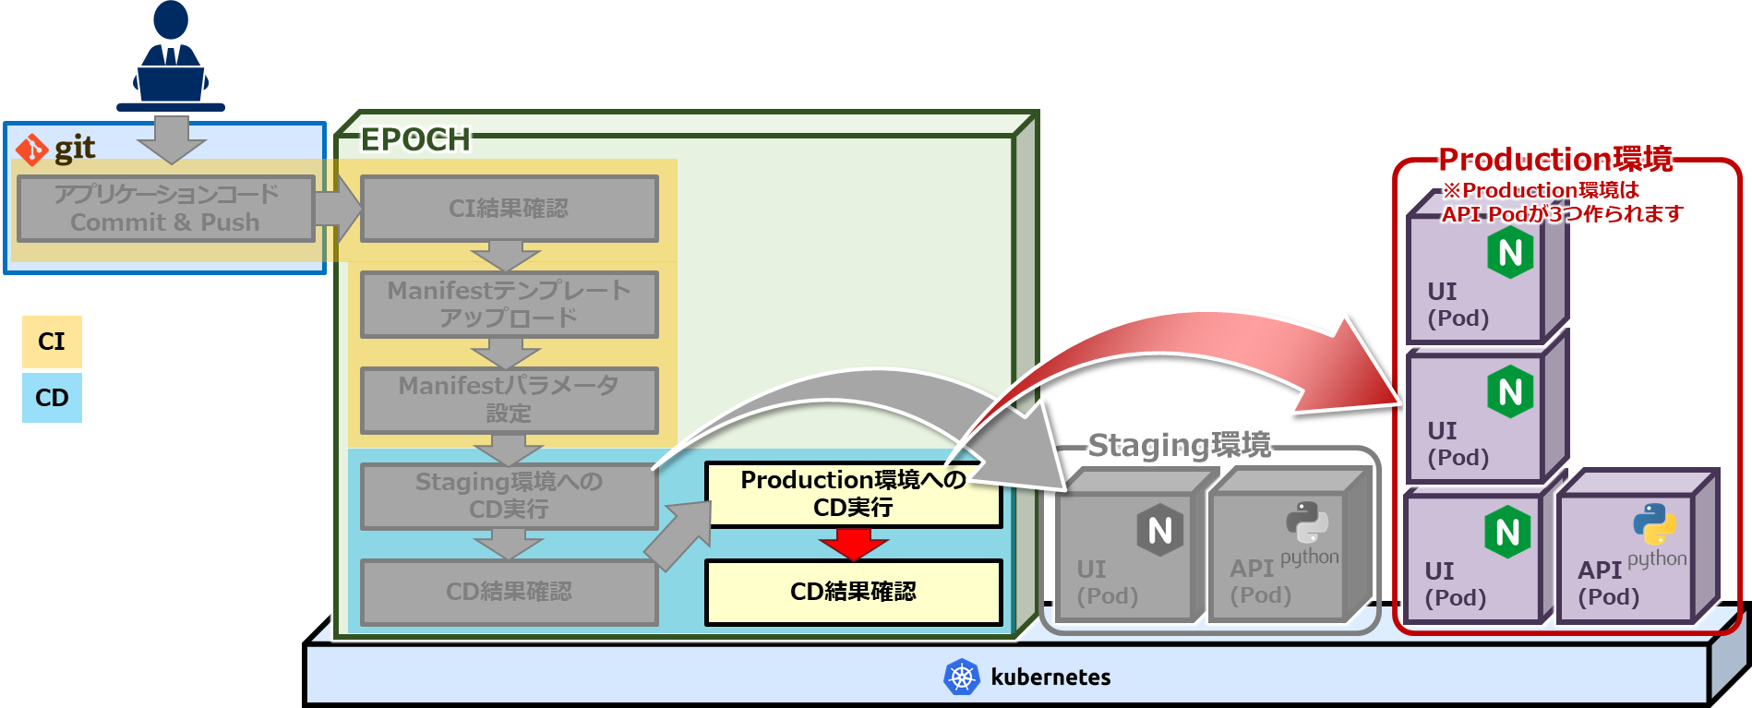
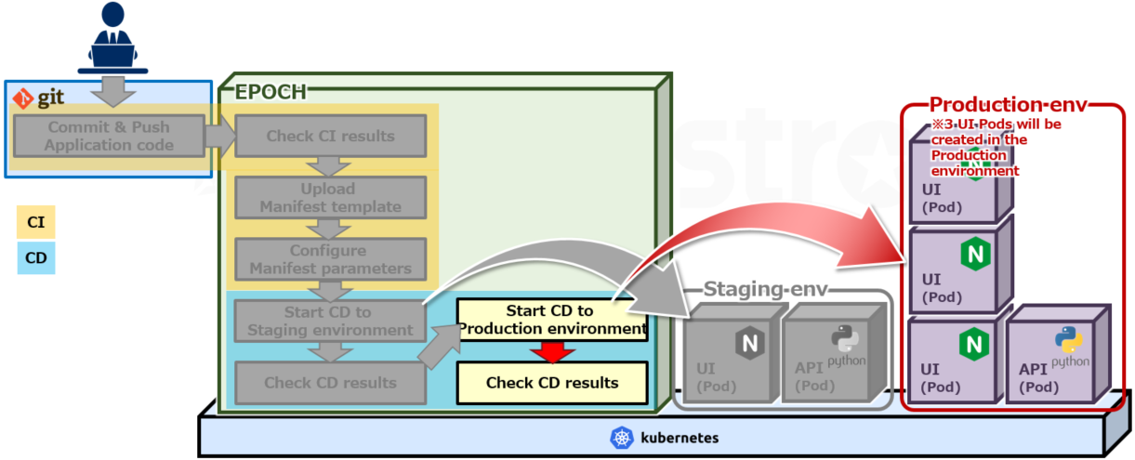
4.5 CI/CD Workflow No.1 (20/25)
Deploy to the Production environment
Start the CD and deploy to the Production environment.
Start CD

Slide 56
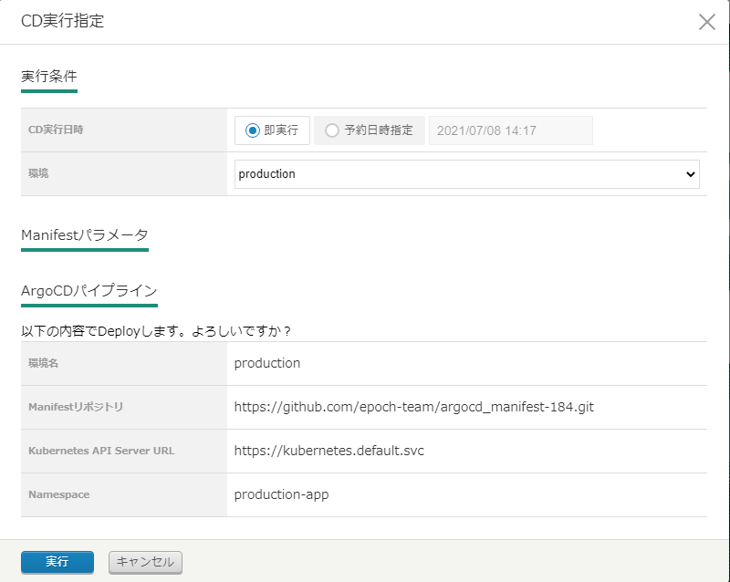
4.5 CI/CD Workflow No.1 (21/25)
Start CD for the Production environment
Select the environment you want to deploy to.
Select “production”
Press “Enter”
The CD process for the Production environment has started.
Let us check that it is working as it should.

Slide 57
4.5 CI/CD Workflow No.1 (22/25)
Check the CD results (Production)
We can check the CD execution results from Exastro IT-Automation and ArgoCD.
Click the different results icons to check the CD execution results.

Slide 58
4.5 CI/CD Workflow No.1 (23/25)
Check that the Manifest file has been created (Production environment)
Open Exastro IT-Automation and check that the Manifest file has been registered to the IaC repository.
LoginID: epoch-user Password: c2jthascR93ijdcyzwJY
[1] Go to Conductor -> Conductor list
[2]Click “Filter”
[3]Press "Details" on the "CD" record.
If all the nodes says “DONE”, then the operation has ended successfully.

Slide 59
4.5 CI/CD Workflow No.1 (24/25)
Check the results of the ArgoCD Pipeline (Production environment)
Check that the Manifest shows up on Kubernetes
Username: admin Password: iYSCKzx2wvxJnn4dCNwN Your browser might say that the connection is not secure. If that is the case, open up the “more information” tab and press “Access”.
ArgoCD synchronizes every 3 minutes.
Select “production”
If the Sync status says "Sync OK", the operation is complete.
※Make sure that the displayed date/time is after the CD was run.
Let us check the deployed sample application

Slide 60
4.5 CI/CD Workflow No.1 (25/25)
Check the Production environment sample code.
Access the sample application from the URL below http://[Kubernetes master node IP address/Host name]:31003/front-end.html
Check that the screen displayed is the same as the one in the Staging environment.
This concludes the first CI/CD Workflow.
In the next section, CI/CD Workflow No.2, we will modify the application code and deploy it once more.

Slide 61
CI/CD Workflow No.2

Slide 62
4.6 CI/CD Workflow No.2 (1/21)
Deploy to the Staging environment
In the second CI/CD Workflow, the user will modify the application code, commit and push it to the Staging environment and finally deploy it.
EPOCH
Production env
Commit & Push Application code
Check CI results
※3 UI Pods will be created in the Production environment
UI
(Pod)
Upload
Manifest template
CI
UI
(Pod)
CD
Configure Manifest parameters
Staging env
Start CD to Staging environment
Start CD to Production environment
UI
(Pod)
API
(Pod)
UI
(Pod)
API
(Pod)
Check CD results
Check CD results

Slide 63
4.6 CI/CD Workflow No.2 (2/21)
Modify application code
Modify the application code and start the second CI/CD process. In this part of the tutorial, we will make it so Euro can be selected as an currency.
Use your code editor and open the following files from the cloned application code repository and modify them.
File ①：api-app/data/currency.json
File 2②：api-app/data/rate.json
6 7 8 9 10 11 12 13 14 | "USD": { "symbol" : "$", "formatter" : "{symbol} {price:,.2f} (Tax Included)" }, "EUR": { "symbol" : "€", "formatter" : "{symbol} {price:,.2f}" } }
Add line 9~12
1 2 3 4 | { "USD": 110.56, "EUR": 134.15 }
Add a comma to the end of line 2
Add line 3

Slide 64
4.6 CI/CD Workflow No.2 (3/21)
Commit and push the application code
Take the modified application code and commit and push it.
Run the following Git commands
※ If you are asked to authenticate yourself when you are running the git push command, input the necessary GitHub account information.
> > > > > | cd “[clone destination folder]" cd epoch-sample-app git add . git commit -m “addcurrency(EUR)" git push origin main

Slide 65
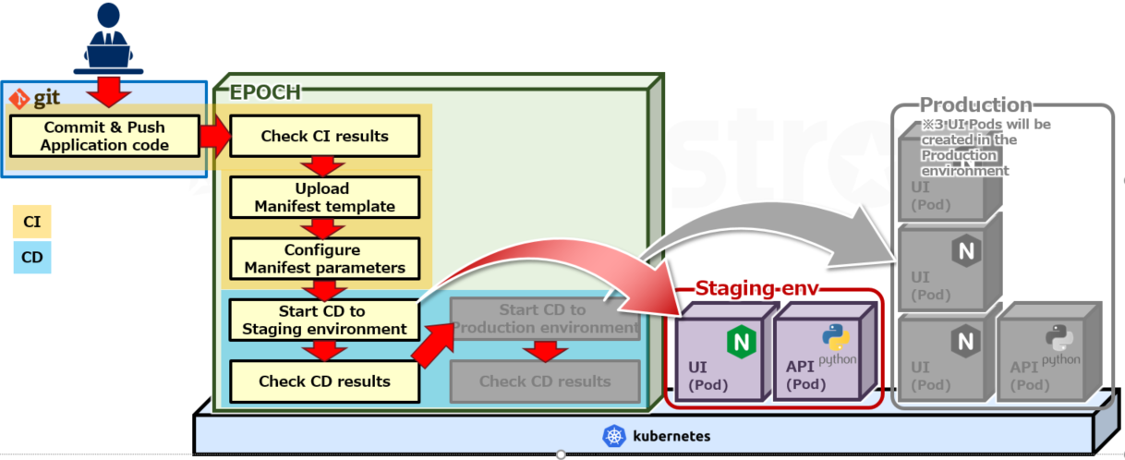
4.6 CI/CD Workflow No.2 (4/21)
Check CI results
Check the build results of the Application code.
Running the Git push command will start the CI Pipeline.
Users can press this icon in order to see the results.

Slide 66
4.6 CI/CD Workflow No.2 (5/21)
Check the TEKTON Pipeline
Check the TEKTON pipeline that the build has ended successfully.
Users can check the CI Pipeline operations from the TEKTON dashboard.
By pressing the name of the operation, users can see more information regarding the CI Pipeline contents.
If the “Status” displays a green checkmark, the operation has ended successfully.

Slide 67
4.6 CI/CD Workflow No.2 (6/21)
Check the Container image tag name
Open the registry service screen and check the tag of the built container image.
Open the Dockerhub screen and check the epoch-sample-api tag.
※If the image isn't registered, check the results from the TEKTON pipeline
The Image tag will be used in the next step where we input it into the Manifest parameter (image_tag), so make sure to save it.
※We plan to make it possible for users to select the image_tag created in the Pipeline.

Slide 68
4.6 CI/CD Workflow No.2 (7/21)
Upload Manifest template
Upload the Manifest template we downloaded earlier
え
In order to run the second CD pipeline, we need to change the image tag in the Manifest parameters. （ There is no need to upload the Manifest templates this time ）

Slide 69
4.6 CI/CD Workflow No.2 (8/21)
Modify Manifest parameter(image_tag)
Change the image tag name for both the staging and the production environment Manifest parameters.
Select api-app.yaml
Modify the staging and production
image_tag
Press “Enter”
api-app.yaml
Item | Input contents(staging) | Input contents(production) | Description
{{ image_tag }} | [The most recent image tag checked in the registry service] | [The most recent image tag checked in the registry service] | Container image tag

Slide 70
4.6 CI/CD Workflow No.2 (9/21)
Deploy to Staging environment
Start CD and deploy to the Staging environment.
Start CD

Slide 71
4.6 CI/CD Workflow No.2 (10/21)
Start CD for the Staging environment
Select your desired environment and start deploying.
Select “staging”
Press “Enter”
The CD process for the Staging environment has started.
Let us check that it is working as it should.

Slide 72
4.6 CI/CD Workflow No.2 (11/21)
Check the CD results
We can check the CD execution results from Exastro IT-Automation and ArgoCD.
Click the different results icons to check the CD execution results.

Slide 73
4.6 CI/CD Workflow No.2 (12/21)
Check that the Manifest file has been created (Staging environment)
Open Exastro IT-Automation and check that the Manifest file has been registered to the IaC repository.
LoginID: epoch-user Password: c2jthascR93ijdcyzwJY
[1] Go to Conductor -> Conductor list
[2]Click “Filter”
[3]Press "Details" on the "CD" record.
If all the nodes says “DONE”, then the operation has ended successfully.

Slide 74
4.6 CI/CD Workflow No.2 (13/21)
Check the results of the ArgoCD Pipeline (Staging environment)
Check that the Manifest shows up on Kubernetes
Username: admin Password: iYSCKzx2wvxJnn4dCNwN Your browser might say that the connection is not secure. If that is the case, open up the “more information” tab and press “Access”.
ArgoCD synchronizes every 3 minutes.
Select “staging”
If the Sync status says "Sync OK", the operation is complete.
※Make sure that the displayed date/time is after the CD was run.
Let us check the deployed sample application

Slide 75
4.6 CI/CD Workflow No.2 (14/21)
Check the Staging environment sample code.
Access the sample application from the URL below http://[Kubernetes master node IP address/Host name]:31001/front-end.html
Check that "YEN“, "USD“, and the newly added “EUR” is displayed and selectable from the Currency pulldown selection.
Now let's deploy to the Production environment

Slide 76
4.6 CI/CD Workflow No.2 (15/21)
Deploy to Production environment
Now that we have deployed to the Staging environment and checked that everything functions as it should, we can now deploy to the Production environment.
EPOCH
Production env
Commit & Push Application code
Check CI results
※3 UI Pods will be created in the Production environment
UI
(Pod)
Upload
Manifest template
CI
UI
(Pod)
CD
Configure Manifest parameters
Staging env
Start CD to Staging environment
Start CD to Production environment
UI
(Pod)
API
(Pod)
UI
(Pod)
API
(Pod)
Check CD results
Check CD results

Slide 77
4.6 CI/CD Workflow No.2 (16/21)
Deploy to the Production environment
Start the CD and deploy to the Production environment.
Start CD

Slide 78
4.6 CI/CD Workflow No.2 (17/21)
Start CD for the Production environment
Select the environment you want to deploy to.
Select “production”
Press “Enter”
The CD process for the Production environment has started.
Let us check that it is working as it should.

Slide 79
4.6 CI/CD Workflow No.2 (18/21)
Check the CD results (Production)
We can check the CD execution results from Exastro IT-Automation and ArgoCD.
Click the different results icons to check the CD execution results.

Slide 80
4.6 CI/CD Workflow No.2 (19/21)
Check that the Manifest file has been created (Production environment)
Open Exastro IT-Automation and check that the Manifest file has been registered to the IaC repository.
LoginID: epoch-user Password: c2jthascR93ijdcyzwJY
[1] Go to Conductor -> Conductor list
[2]Click “Filter”
[3]Press "Details" on the "CD" record.
If all the nodes says “DONE”, then the operation has ended successfully.

Slide 81
4.6 CI/CD Workflow No.2 (20/21)
Check the results of the ArgoCD Pipeline (Production environment)
Check that the Manifest shows up on Kubernetes
Username: admin Password: iYSCKzx2wvxJnn4dCNwN Your browser might say that the connection is not secure. If that is the case, open up the “more information” tab and press “Access”.
ArgoCD synchronizes every 3 minutes.
Select “production”
If the Sync status says "Sync OK", the operation is complete.
※Make sure that the displayed date/time is after the CD was run.
Let us check the deployed sample application

Slide 82
4.6 CI/CD Workflow No.2 (21/21)
Check the Production environment sample code.
Access the sample application from the URL below http://[Kubernetes master node IP address/Host name]:31003/front-end.html
Check that the screen displayed is the same as the one in the Staging environment.
This concludes the tutorial.

Slide 83
5. Appendix
The next section contains supplementary information for the tutorial.

Slide 84
5.1 Restrictions
The following are the restrictions that are present in the current Exastro EPOCH version and may be subject to change.
Restrictions（Planned fix in the future）
Only 1 application code repository is supported at the moment.
You can only have one collective Git account for the application codes.
An option for selecting Git service is planned to be added in future releases. Only Git repository URLs are supported in this version.
Support for build branches is planned to be added in future releases. Only pushed contents is supported in this version.
Support for Static response analysis is planned to be added in future releases. 現在はSonarQubeを選択した場合に動作しません。
The only registry service supported is the internal registry service.
Items other than the image output destination is planned to be added in future releases.
Support for Authentication tokens and Base64 encoded certificates is planned to be added in future releases.
The variables that can be specified in the template are fixed. Please see "Column" for more information.
Points to note
Installing EPOCH will also install TEKTON.
The ”{{ Variable name }}” variables are specified contents.

Slide 85
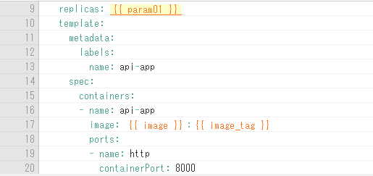
Column：Manifest templates and their variable names
When a Manifest template is uploaded to EPOCH, the system will analyze pre-defined text and make them into modifiable parameters.
Strings that are described in this format : {{ Variable name }} will be recognized as user-inputable variables. The variables that can be used in the current version of EPOCH are the following:
Variable name | Description
{{ image }} | Container image
{{ image_tag }} | Container image tag
{{ param01 }} | Fixed variables that users can use freely.
～
{{ param20 }} | Fixed variables that users can use freely.（Can use max 20）
※Support for user-specified variable names is planned to be added in future releases.

